Slide 1

Improving Text Extraction Accuracy with Image Preprocessing
Under the guidance of Dr. T. Sridevi
BE2102-07
1601 18 733 067
1601 18 733 081

Slide 2
Agenda
Problem Statement
Methodology
Project Status
Architecture
Image Processing Pipeline
Next steps

Slide 3
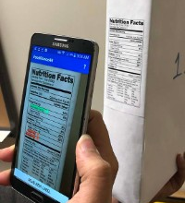
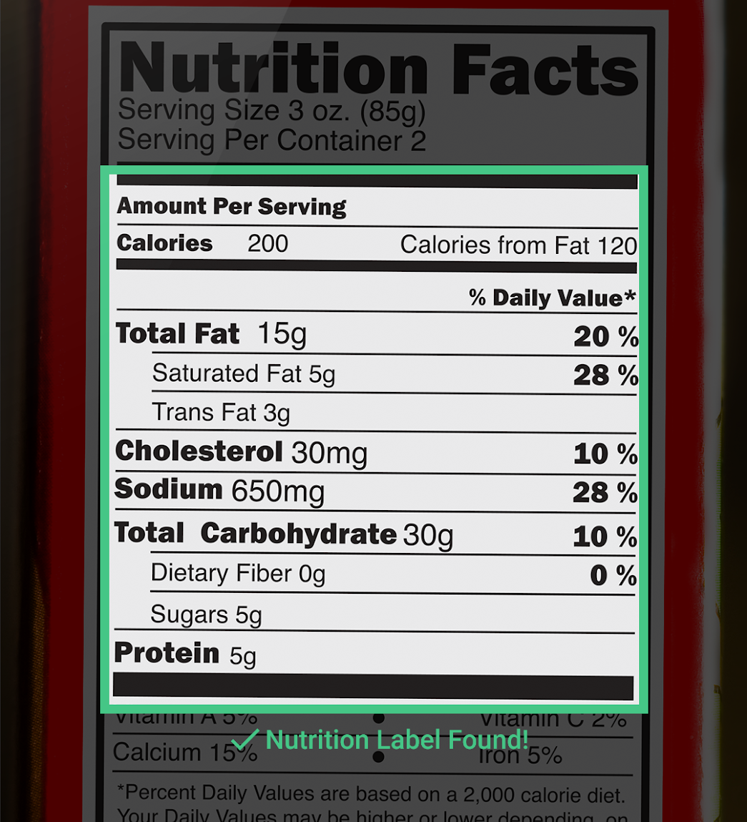
Advancements in computer vision have paved the way by providing tools for text detection and extraction. It’s been observed that the accuracy of the extracted text is relatively low and contains a lot of noise. The aim is to extend the current pipeline to improve the accuracy by
Improving the quality of the image
Using NLP to extract information from raw text

Slide 4
Methodology

Slide 5










Methodology
Scanned Image File Upload
Image Preprocessing Pipeline
Optical Character Recognition
Text Extraction
Information Extraction
Text - to - Speech Conversion
Document
Scan
Notes:
Preprocessing pipeline workflow
Speech to text

Slide 6
Project Status

Slide 7
Architecture

Slide 8
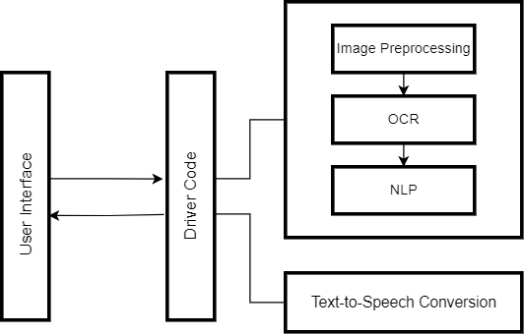
Architecture

Slide 9
Image Preprocessing

Slide 10
Image Preprocessing
Convert Image to Grayscale
Skewness Correction
Sharpening
Brightness Correction
Load Image
Is Grayscale Image?
Document Detection
Is Image Skewed?
Is Image Blurred?
Is Image Shadowed?
Noise Removal
Edge Detection
Contour Detection

Slide 11
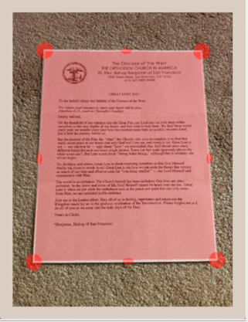
Document Detection
Detecting the boundaries of objects within the image
Canny Edge Detection
Detecting the document from the image
cv2.findContours( )

Slide 12
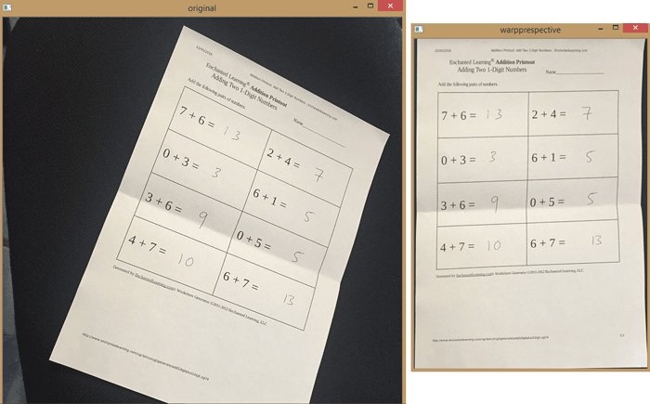
Image Skewness
Detecting the edges of the image.
Finding Hough lines between 0.1 to 180 degree angle
hough_line(edges, theta=tested_angles)
Finding the angle with the highest occurrence.
Rotating the image

Slide 13
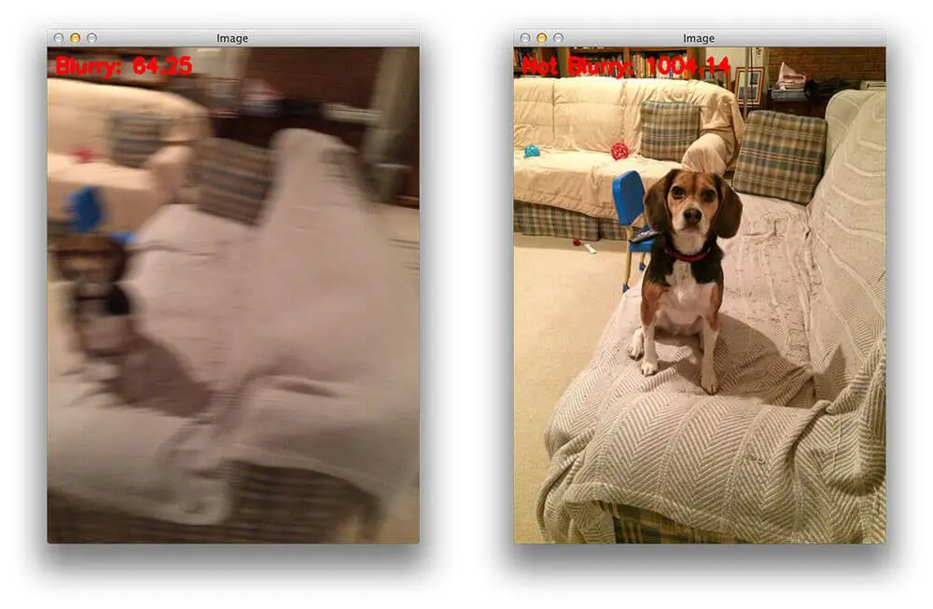
Image Sharpening
Detecting whether an image is blurry and correcting it according to that degree.
v2.Laplacian(image, cv2.CV_64F).var()
If the variance falls below a predefined threshold, then the image is considered blurry; otherwise, the image is not blurry.

Slide 14
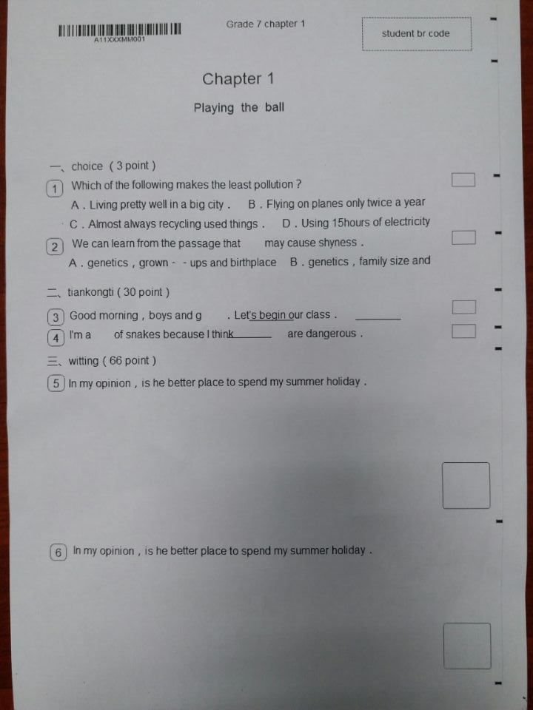
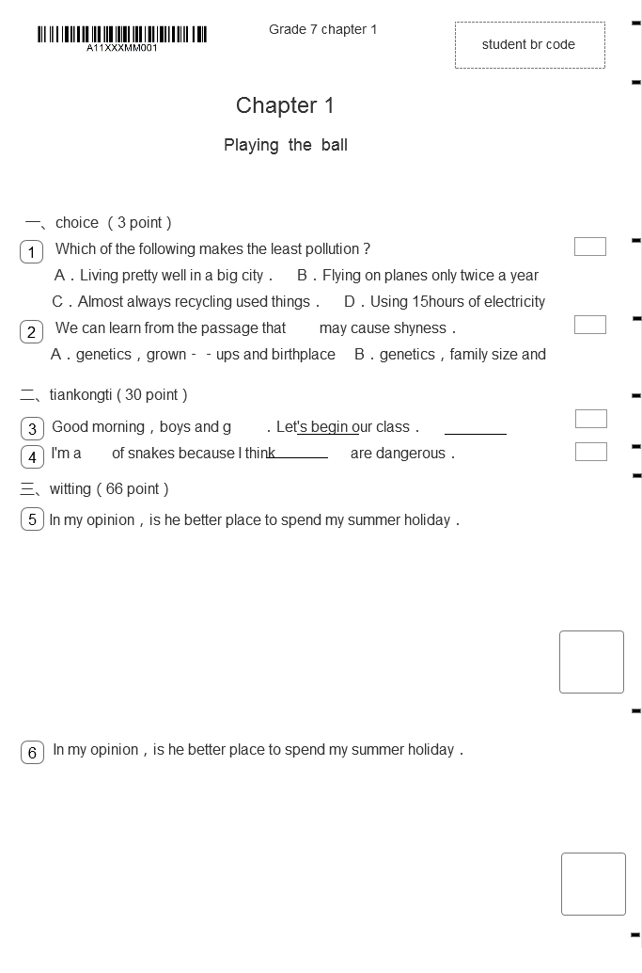
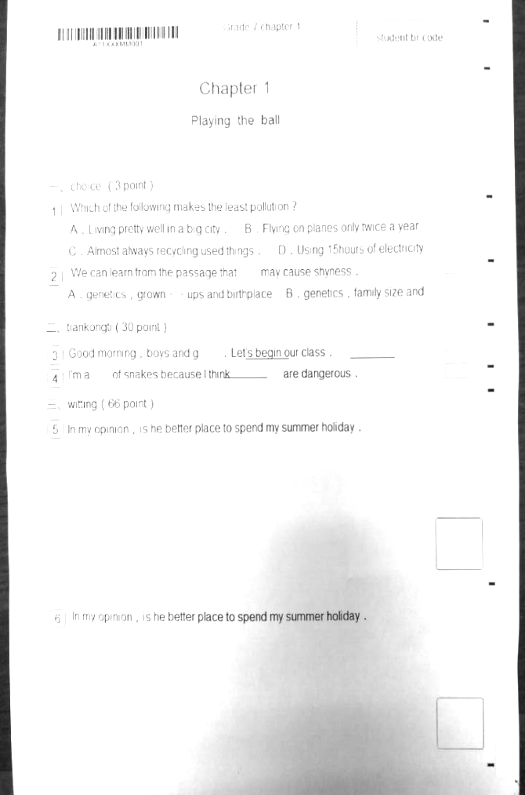
Shadowed Image
Detecting whether an image contains a shadow and brightening that region.
Dilate the image, in order to get preserve the text.
Median blur to further suppress any text.
Calculate the difference
Normalize the Image
Truncate and Normalize again

Slide 15
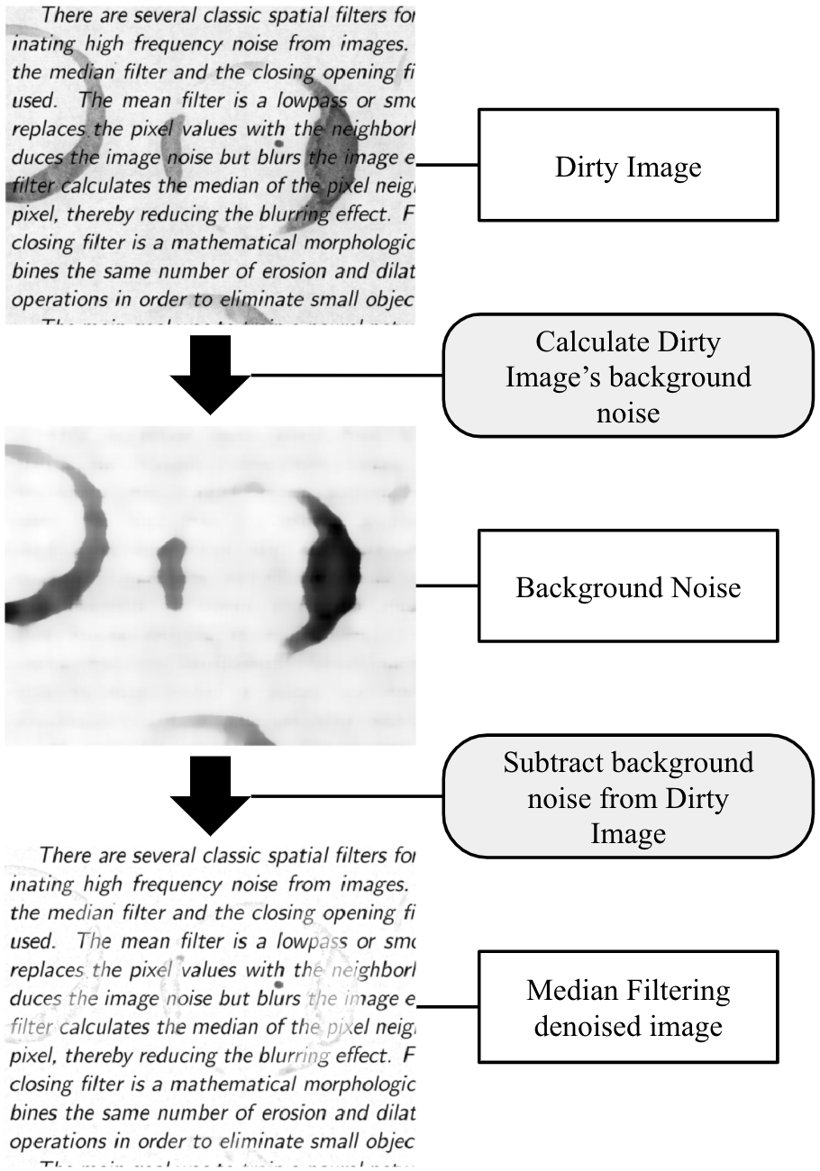
Noise Removal
Detecting whether the image has other forms of noise present in it. This includes salt and pepper noise, watermarks or other dark regions
Isolate the background noise
Removing it from the Image through subtraction

Slide 16
Next Steps

Slide 17
Thank You

